Slide 1
Cricket Game
Democratizing the Skills Required to be Successful in the Game

Slide 2
Knowledge vs Skill vs Ability
Knowledge | Skill | Ability
Theoretical or practical understanding of a subject | Proficiencies developed through training and experience | Quality of being able to do something
Acquired through learning or experience | Practise or learned behaviour | Natural or Inbuilt
Knowledge increases with experience | Skills can be developed with practise | Ability can be improved to a certain extent
Teachable | Teachable | Unteachable & Hard to transfer
Explicit, Implicit | Tacit | Tacit

Slide 3
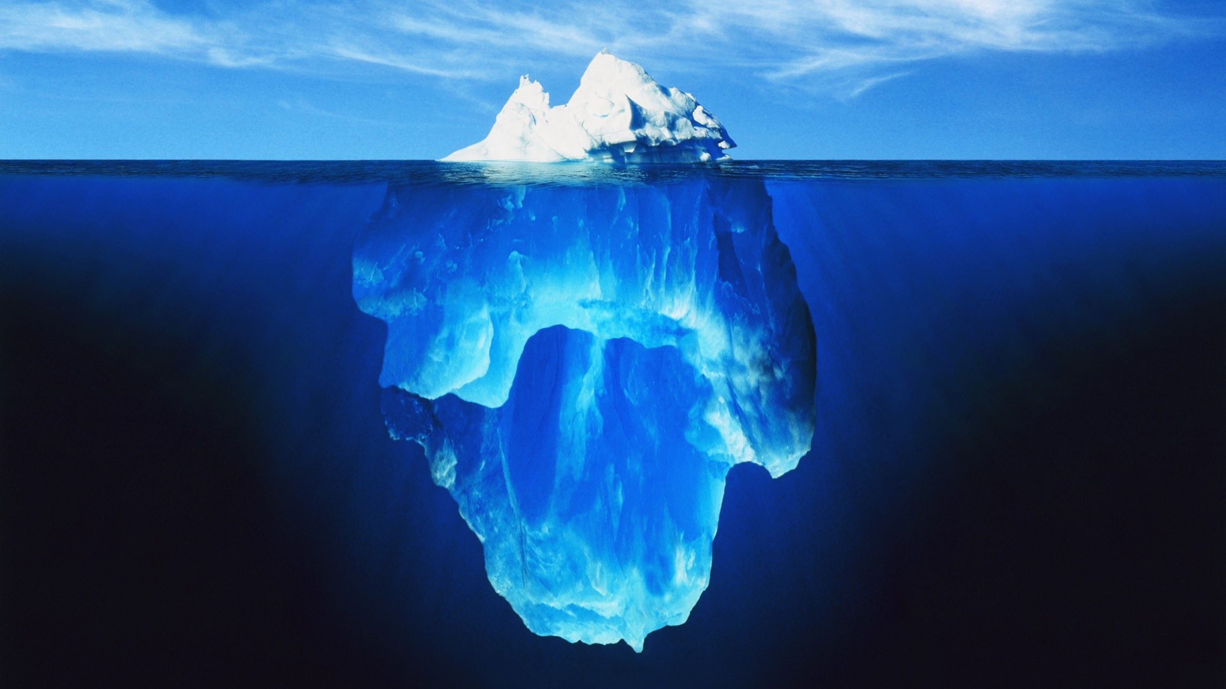
Types of Knowledge
Explicit
Level 1: Statistics, Physical attributes
Codified and easy to capture
Implicit
Level 2: Coaching manuals, Guides and Playbooks
Can be articulated with some help such as procedures
Tacit
Level 3: Hunch, Experience, motor and cognitive skills, emotional responses, Insights and Intuitions
Intuitive knowledge and know-how, hard to communicate as it is on the mind of the person

Slide 4
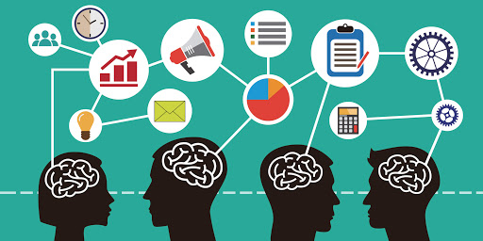
Knowledge Capture & Modelling
"Knowledge Capture and Modelling (KCM) – or in short Knowledge Modelling – is a cross disciplinary approach to capture and model knowledge into a reusable format for purpose of preserving, improving, sharing, substituting, aggregating and reapplying it. In the computer world it is used to simulate intelligence."

Slide 5

Knowledge Capture & Modelling
Model Types: Good for Explicit & Implicit Knowledge
Diagnostic Models
Used for diagnosing problems by categorizing and framing problems in order to determine the root or possible cause
Explorative Models
This type of model is designed to produce possible options for a specific case
Hybrid Models
Selective Models
This type of model is used mainly for the decision-making process in order to assess or select different options
Analytic Models
Analytical Models are mainly used for analysing pre-selected options. This type of model has the ability to assess suitability, risk or any other desire fitness attributes
Instructive Models
Instructive (or Prescriptive) models provide guidance in a bidirectional or interactive process
Constructive Models
A Constructive Model is able to design or construct the solution, rather than instructing it
In many cases more advanced models are constructed by nesting or chaining several models together.
Notes:
http://www.makhfi.com/KCM_intro.htm

Slide 6
Knowledge Capture & Modelling
Technology Options: Good for Explicit & Implicit Knowledge
DECISION TREE & AHP
BAYESIAN NETWORKS & ANP
ARTIFICIAL NEURAL NETWORK
GENETIC & EVOLUTIONARY ALGORITHMS
EXPERT SYSTEMS
STATISTICAL MODELS
RULE ENGINES
WORKFLOW SYSTEMS
A Decision Tree is a graph of options and their possible consequences used to create a plan in order to reach a common goal
An intuitive way to identify and embody the essential elements, such as decisions, uncertainties, and objectives in effort to better understand how each one influence the other.
It is a non-linear mathematical or computational model for information processing. ANN is an adaptive system that changes its structure based on external or internal information that flows through the network.
Inspired by biological evolution, including inheritance, mutation, natural selection, and recombination (or crossover), genetic and evolutionary algorithms are used to discover approximate solutions
Expert Systems are the forefathers of capturing and reusing experts’ knowledge, and they typically consist of a set of rules that analyze information about a specific case.
Statistical Models are mathematical models developed through the use of empirical data.
Rule Engines are used to answer complex questions in order to infer possible answers or are used to detect and react to interesting patterns of events occurring and reacting.
A Workflow System manages the operational aspect of a work procedure
Notes:
http://www.makhfi.com/KCM_intro.htm

Slide 7

Transfer of Tacit Knowledge to AI
ML-based AI can create new tacit knowledge and it can learn through socialization:
1.Supervised ML algorithms are good at capturing tacit knowledge shared by many individuals.
2.Reinforcement learning ML algorithms are capable of creating new tacit knowledge through experimentation.
“If a typical person can do a mental task with less than one second of thought, we can probably automate it using AI either now or in the near future.”
The first generation of AI relied heavily on explicit knowledge articulated by humans. The creation of such systems proved to be expensive and labor intensive, arguably because of their heavy reliance on explicit knowledge
Supervised Learning can be used to capture and gain Tacit knowledge from individuals
The easiest way to obtain such training data is to “observe” humans perform the underlying prediction (or classification) tasks, this approach works only if a sufficient number of humans already possess the tacit knowledge necessary to perform such tasks
AI built around capturing human tacit knowledge can contribute to the knowledge creation spiral in two ways:
Capturing the wisdom of crowds
Simplifying the transfer of relatively specialized tacit knowledge from actors possessing such knowledge to others without the need for a direct interaction between the two groups
Notes:
https://www.linkedin.com/pulse/organizational-knowledge-creation-age-ai-part-2-anna-sidorova/

Slide 8


AI will help in passing on skills amongst workers
AI will assist in the transfer of skills from one generation to the other
Case Study:
Engineering giant Honeywell has developed tools which utilize augmented and virtual reality (AR/VR) along with AI, to capture the experience of work and extract “lessons” from it which can be passed on to newer hires
Employees wear AR headsets while carrying out their daily tasks. These capture a record of everything the engineer does, using image recognition technology, which can be played back, allowing trainees or new hires to experience the role through VR
Information from the video imagery is also being used to build AR tools which provide real-time feedback while engineers carry out their job – alerting them to dangers or reminding them to carry out routine tasks when they are in a particular place or looking at a particular object.
Notes:
https://www.forbes.com/sites/bernardmarr/2019/05/29/artificial-intelligence-in-the-workplace-how-ai-is-transforming-your-employee-experience/#7c58c85653ce

Slide 9
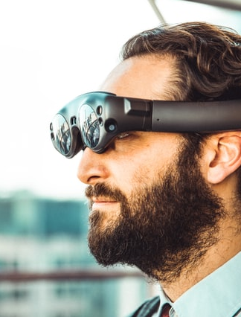



Creating the Internet of Skills
Key Pillars:
Artificial Intelligence
5G
Haptics
Internet of Skills enables you to transfer your expertise, irrespective of distance/location, in real time, using robotics and haptic feedback
Capturing tacit knowledge using AI will play a huge role in this process as it would be able to create a digital repository of skills

Slide 10
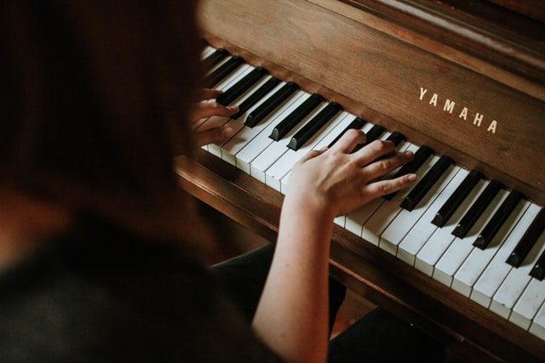
Creating the Internet of Skills
Examples:
Playing the piano:
To start off, the expert/teacher would put on a haptic glove — this glove is tracking and recording every single movement of their hand and fingers, which is stored on a standardised skills database.
An aspiring pianist can then download this real-time onto an exoskeleton, which will gently pressurise the hands and the joints, moving them softly at the beginning, and nudging the body into the right shape, until the muscle memory is trained. And they don’t even have to be at a piano — they can practice their muscle memory anywhere they want.

Slide 11

Creating the Internet of Skills
Examples:
Surgery:
Surgeon wears the glove, which records their key movements, which are put on a surgery database. This can be downloaded by students anywhere in the world, or, the movements can be used real-time to control a robotic arm.
Sensors on the tip of a robotic arm transfer tactile data back to the doctor operating remotely, through the use of a haptic glove, which in turn controls the movements of the robot.
Along with a virtual reality headset, the doctor can be totally immersed in an operation performed by telepresence. In addition to the sensors and virtual immersion, a 360 camera can provide a live feed and transfer of visual data to the doctor.

Slide 12
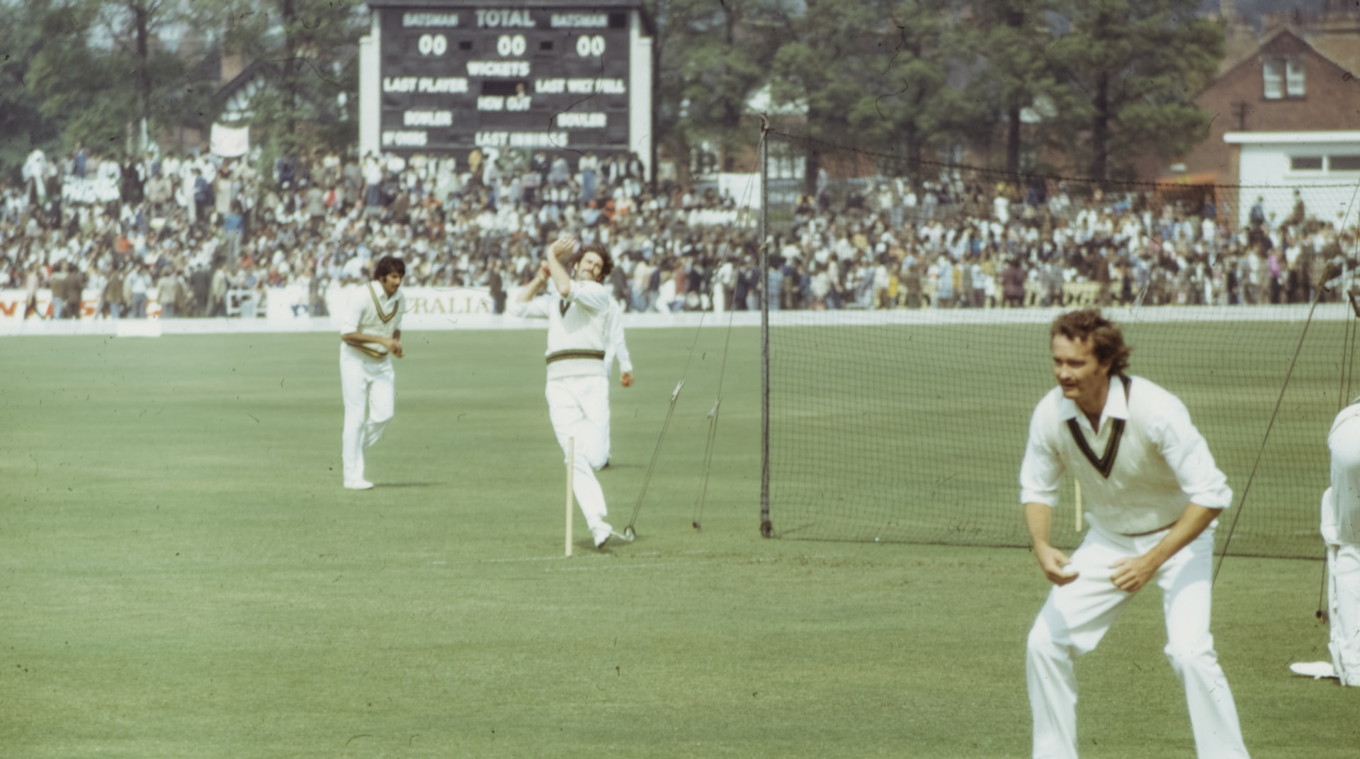
CRICKET GAME

Slide 13

Problem Statement
How do we apply the concepts of knowledge management along with AI and Internet of Skills to improve the way cricket is played and players are trained all the way down to the grass root level
Ultimate Goal
“To create a system to record the tacit knowledge as well as skills of individuals using an AI-ML based system, thereby capturing the experience of workers and generating lessons/insights from it which will then be passed onto other workers or the next generation of the workforce”
When we couple this with other emerging technologies such as 5G and Haptics, it will bring about the Internet of Skills, knowledge that can be shared immediately and openly, breaking down economic barriers and geographic boundaries.
Notes:
https://medium.com/@ishamaggu/an-introduction-to-the-internet-of-skills-5ea884976877

Slide 14
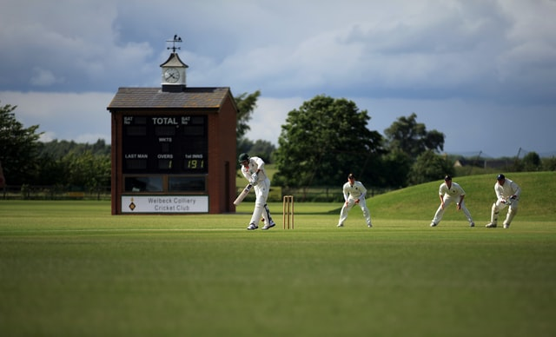
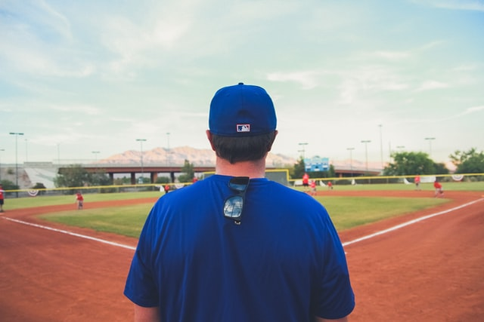
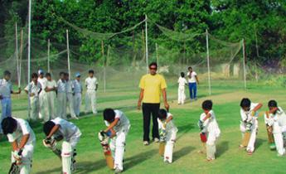
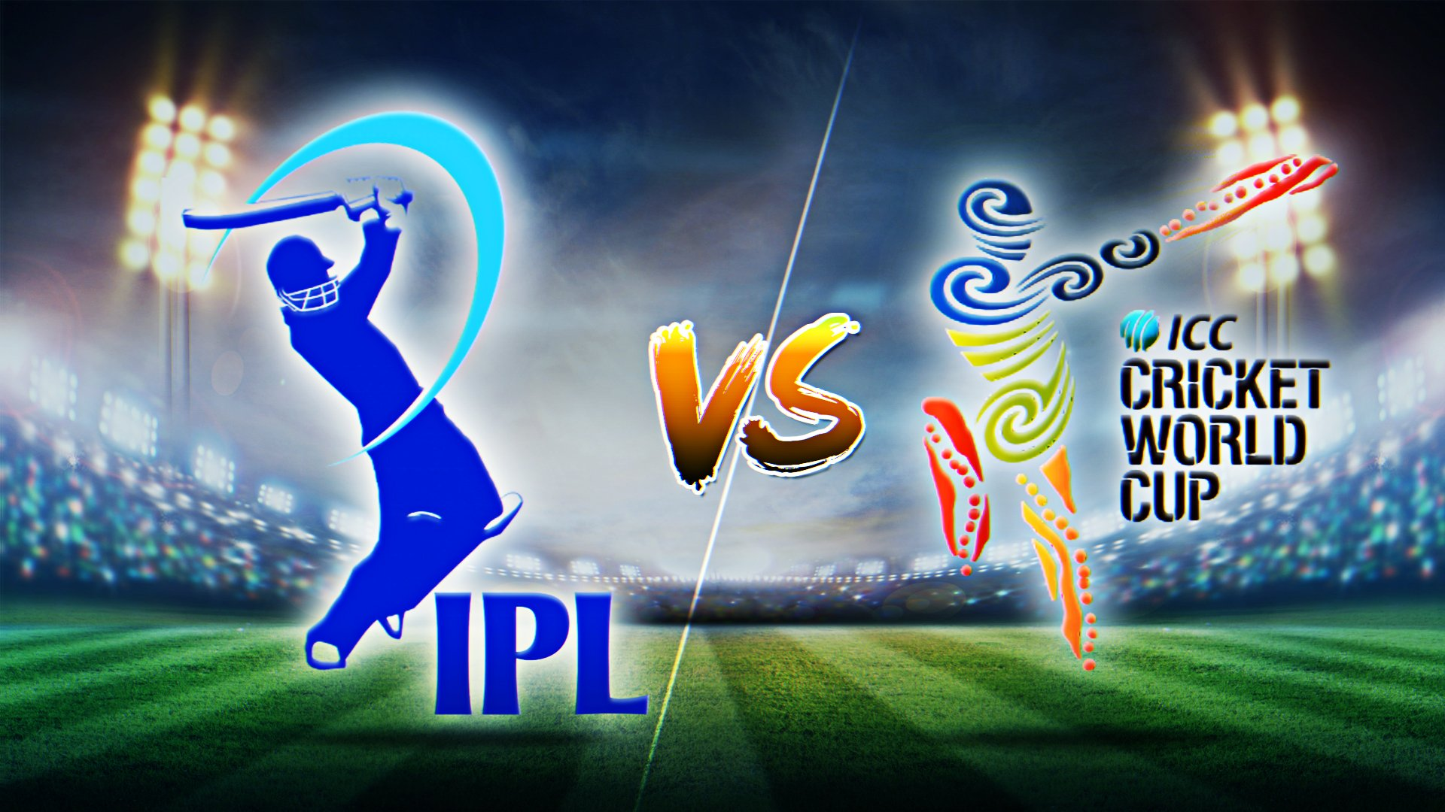
Stakeholders
Players
Coaches
Academies
Cricket Associations
What’s in it for me?
The players can get access to the best bowlers in the virtual world and play in international quality conditions while getting filtered and analytical advice about their technique
What’s in it for me?
The coaches can guide their players better and measure their progress using verifiable data
What’s in it for me?
Academies will have better players as they get trained with the digital twins of world class athletes
What’s in it for me?
Increase the interest in the sport using these training and gaming platforms as users get to experience how is it to play against their favourite superstars and get better players coming up from the grass root levels as the playing standard because of the enhanced trainings

Slide 15
How Can Players Get Trained Today
Training at Academy with a Coach
Player relies on the coach’s experience and is thus limited by that
No data backed insights
Player trains against a limited number of players having limited skill levels
Training at Academy with a Coach utilizing Current Technology
Player relies on the coach’s experience and also gets insights from sensor data
Data helps player get better but is limited by the coach’s experience
Player trains against a limited number of players having limited skill levels
Self Learning with no Formal Training
Player does not get any insight about techniques or playing style
Learning by watching others play
Player trains against a limited number of players having limited skill levels
Self Learning in VR Cricket Environment
Player gets limited insight about techniques and playing style from the inbuilt AI system
Player trains against programmed bowls which do not represent actual bowling styles
Player does not get specific advice from a specialised coach

Slide 16




Ecosystem Vision
Get Better & Play
Players
Tournaments
Get Recognized & Selected
Feedback
Skill Capture System
Coach
Analyse
Train
Players
Digital Twin
Purchase
AI Model
VR Cricket Training System
Train
Players
Purchase
Digital Twin
Analyse
Coach
Feedback
Tournaments
Get Recognized & Selected
Players
Get Better & Play

Slide 17
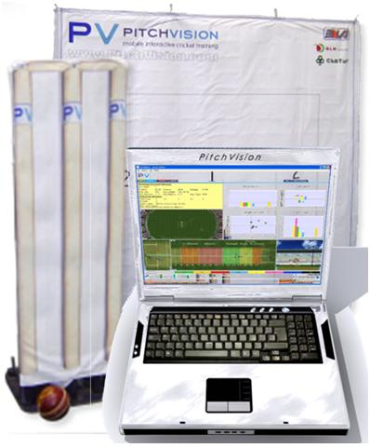
Technological Advances in Cricket Training
Pitch Vision
PitchVision captures and sends performance feedback instantly to a centralized laptop in ‘real-time’ as players train. It automatically creates a complete overview of all activity taking place; from the delivery of the ball, to the final destination from the bat.
Each player’s data can be displayed instantaneously to a laptop, mobile phone and most commonly on-line for later analysis and communication with the coach.
Every training session is stored to build up a historical data base and compared against past performance, peers and professional players.
Bowling:
Measure and record bowler Pace, Line, Length, Deviation, Bounce, and foot position on bowling crease ball by ball
More specifically, how fast (or slow) to bowl when you’re bowling really well
Monitor your flight, use of the bowling crease, deviation & bounce and identify trends
See how often you actually land your stock ball or your wicket ball
See a map of your line and length, graphs and charts of every area of your game
Compare your performance to previous sessions and measure you’re improvement or areas to work on
Batting:
See whether your shots would have pierced the field / Are you getting value for your shots
Identify which specific deliveries get you in trouble
Compare your performance against different bowlers
Bat in real game scenarios against real field placements
See a ‘Wagon Wheel’ of shots from the session
Confirm whether you are constantly getting to the pitch of the ball
Notes:
http://www.cricketlab.co/cricket-technology-pitch-vision.html
https://www.redbull.com/in-en/pitchvision-pv-one
The entire PV/One set up costs Rs 3.5 lakhs

Slide 18
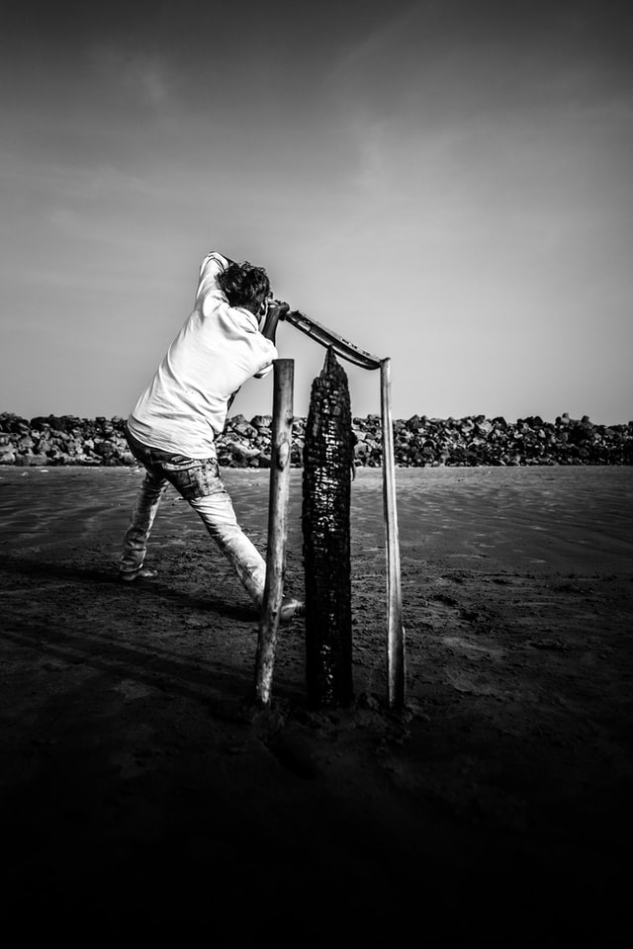
Technological Advances in Cricket Training
Spektakom
Bengaluru-based Spektacom Technologies was founded by former Team India cricketer Anil Kumble
It recently partnered with Microsoft to launch an AI-enabled chip that sticks to normal cricket bats and turns them into “power bats”
These bats are able to capture multiple metrics when a shot is played, and throw up meaningful data insights into a batsman’s game.
Str8bat
Bengaluru-based Str8bat Sports Tech Solutions has developed a wearable device that attaches itself to cricket bats and aids in the coaching process
The IoT-enabled sensor records data including bat angle, accelerated downswing, bat speed, the wagon wheel, and speed impact, and helps budding cricketers understand their game better.
Notes:
http://www.cricketlab.co/cricket-technology-pitch-vision.html
https://yourstory.com/2018/10/startups-bringing-new-technologies-innovation-cricket

Slide 19

Technological Advances in Cricket Training
SeeHow
SeeHow’s sensors are baked into cricket balls and bat handles to track very specific types of data that batsmen and bowlers generate
For bowlers, the sensor tracks speed, spin, seam position or orientation, and length — where the ball lands on the pitch
For batsmen, the sensor tracks swing speed and angle, where it hits on the bat, what kind of deliveries they played, what their responses were to a particular delivery and the velocity of the ball off the bat.
This data is then streamed in real time and can be read by players and coaches alike on the app. The app retains a history of a player’s progress in order to make any necessary adjustments and to track improvements
Stance Beam
Provides session insights, the power generated from a swing, angles and directions of a swing and a 3D analysis of a batsman’s swing.
It does so through a hardware extension that players attach to the ends of their bats and that relays data via an app.
Notes:
https://techcrunch.com/2020/02/27/seehow-helps-cricketers-train-smarter/

Slide 20

Technological Advances in Cricket Training
iB Cricket-VR Experience
Created by integrating AI, IoT, and AI
Accurate Physics to replicate real world cricketing conditions
Advanced built-in AI makes fielding very natural and seamless
Artificial Intelligence powered coach analyses and assists you to hone your talent and perfect your batting skills
Patent-pending electronic bat is integrated with haptic feedback mechanism, i.e., when you hit the virtual ball, you’ll feel the knock
Personalisation options in terms of pitch type, bowler and conditions selection
Notes:
https://ib.cricket/

Slide 21
Features Required to Make the Training System Robust: Batting
Good to Have Features
Differentiating Features
Accurate physics systems in the Virtual World
See whether your shots would have pierced the field / Are you getting value for your shots
Identify which specific deliveries get you in trouble
Compare your performance against different bowlers
Bat in real game scenarios against real field placements
See a ‘Wagon Wheel’ of shots from the session
Confirm whether you are constantly getting to the pitch of the ball
Haptic feedback while hitting the ball in the Virtual world
Track swing speed and angle, where it hits on the bat, what kind of deliveries they played, what their responses were to a particular delivery and the velocity of the ball off the bat.
Ability to view data in real time to coaches. Retains a history of a player’s progress in order to make any necessary adjustments and to track improvements
Provide session insights, the power generated from a swing, angles and directions of a swing and a 3D analysis of a batsman’s swing
The IoT-enabled sensor to record data including bat angle, accelerated downswing, bat speed, the wagon wheel, and speed impact
Realistic Visuals inside the VR world of the stadium and players
Ability to capture the bowling style of any bowler and create a digital twin of the same
Ability to dynamically change delivery length, pace and other parameters based on the pervious delivery and its outcome
Play against a wide repository of real world player’s digitalized selves
Accurately replicate patterns and deliveries of real world bowlers
Ability to add digital twins of players with minimal effort within the system

Slide 22
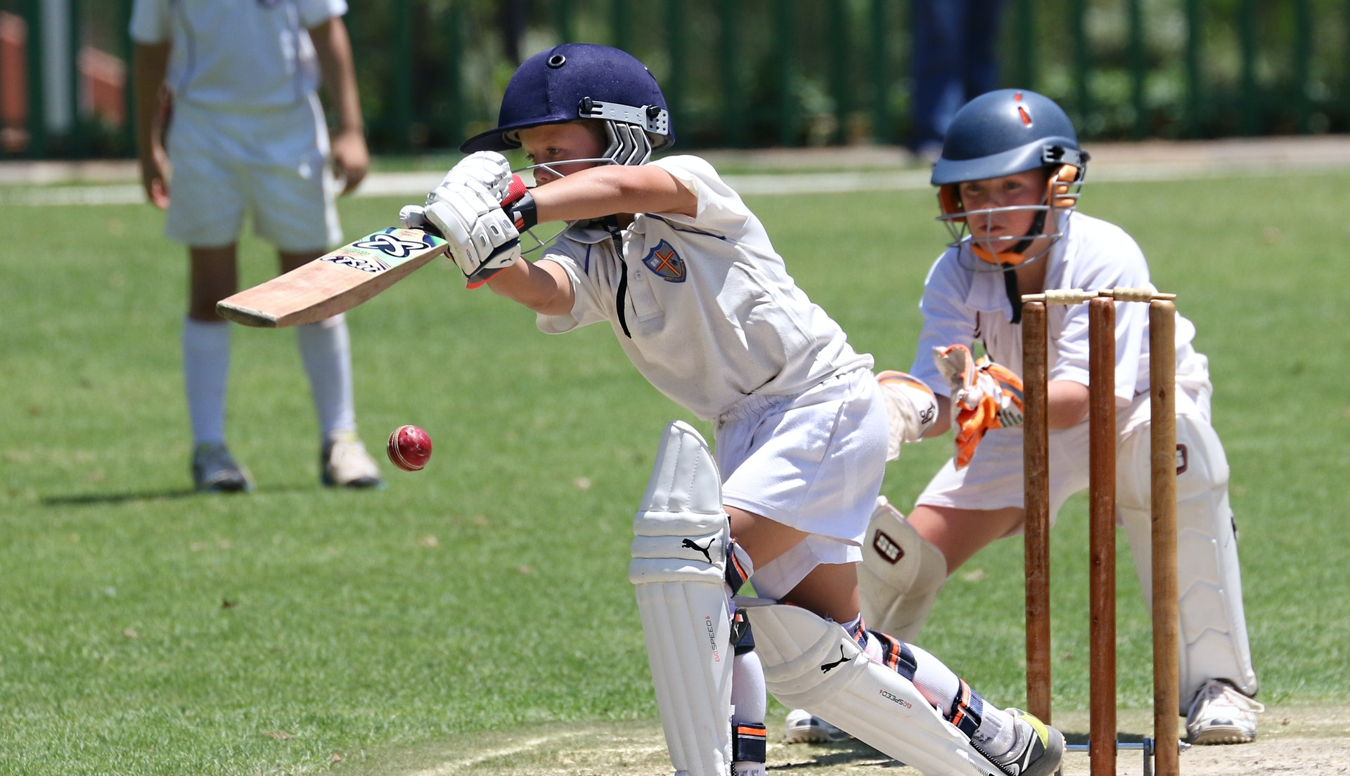
Storyboard

Slide 23
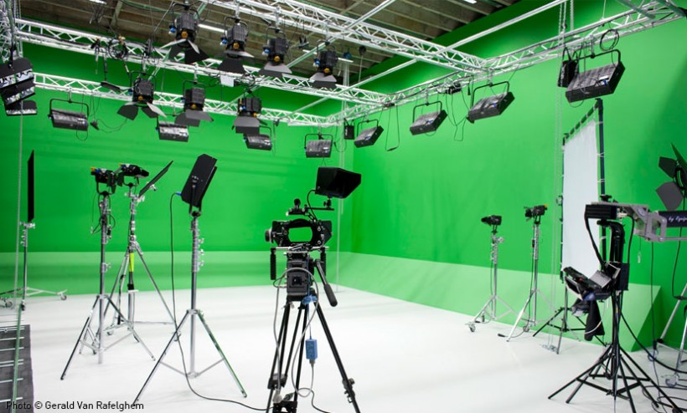
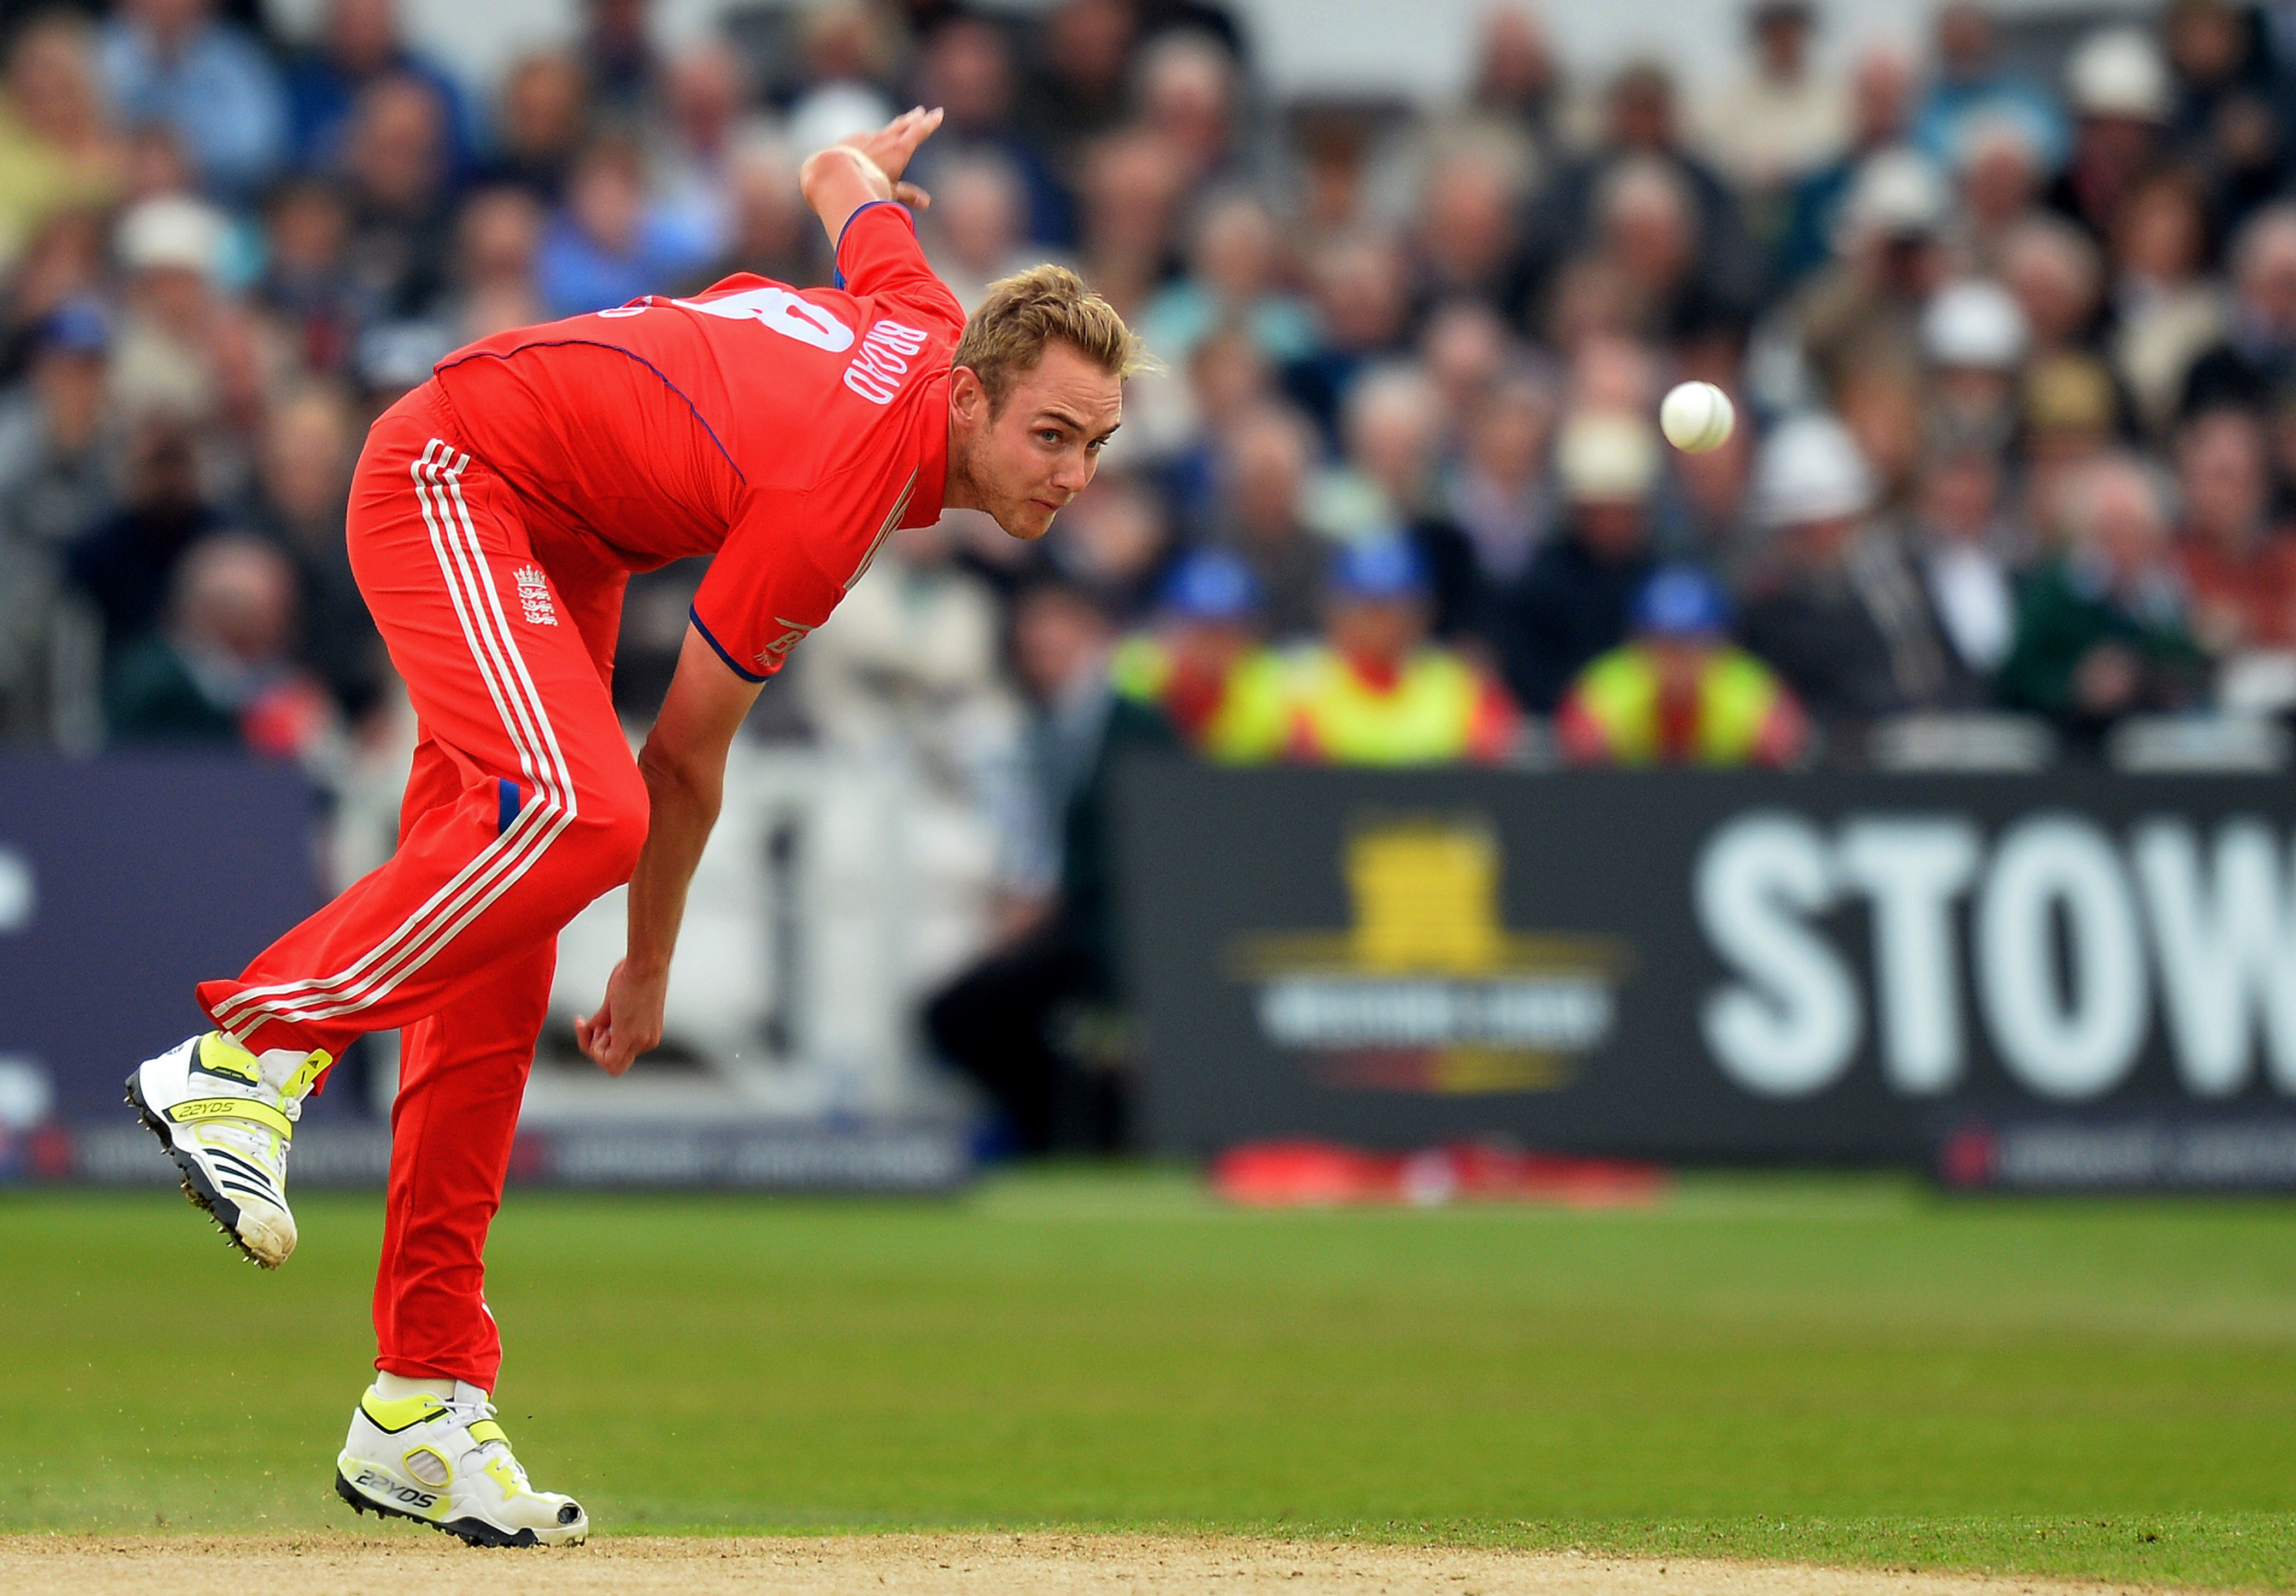
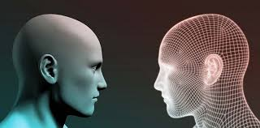
Capturing the Skill Set
01
02
03
The skill capture infrastructure is set up, world-class bowlers and players can come into this facility for the digital twin creation
The bowler comes in and has to bowl a specific number of deliveries covering all his variations for different situations
The system captures all the movements of the player. It also records the pace, spin angle, swing types, variations and bounce for each delivery type enabling us to create a digital replica of the player as well as his skills

Slide 24

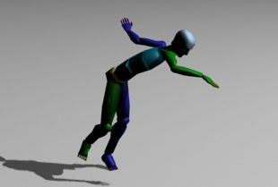
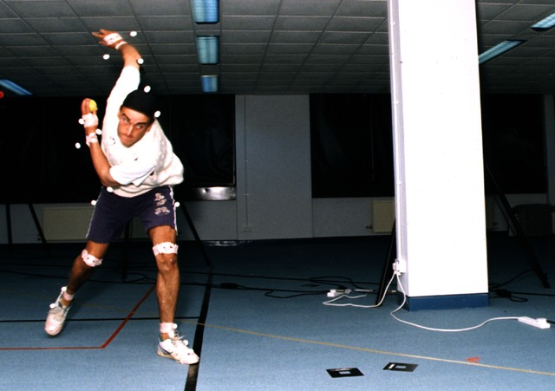
Capturing the Skill Set
04
05
06
Supervised Learning and Reinforcement Learning algorithms are run on the captured digital twin to train the system
The digital twin is rewarded based on the outcome of the previous ball enabling it to dynamically change bowling parameters according to the outcome of the previous delivery
Repeat this process until a variety of bowling styles are captured and we have a large enough inventory of skills

Slide 25
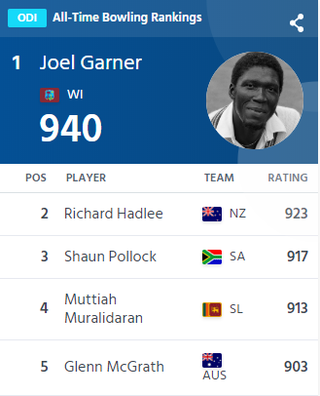
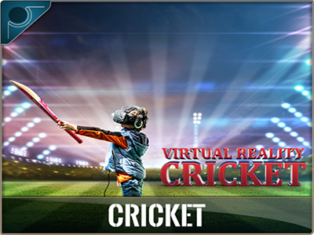
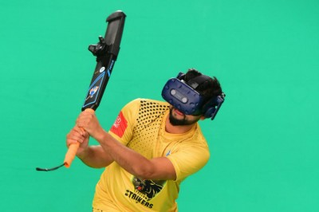
Playing the Game
07
08
09
The trained model is integrated with a gamified VR Cricket environment for the players to experience and get trained on
The batsman enters the virtual environment with a physical bat having sensors attached to it for recording parameters such as bat speed, swing, angle, etc.
Batsman can choose:
Format (t20/ODI/Test/Custom Format)
Pitch Conditions
Bowler to play against
Weather Conditions
Difficulty Level

Slide 26
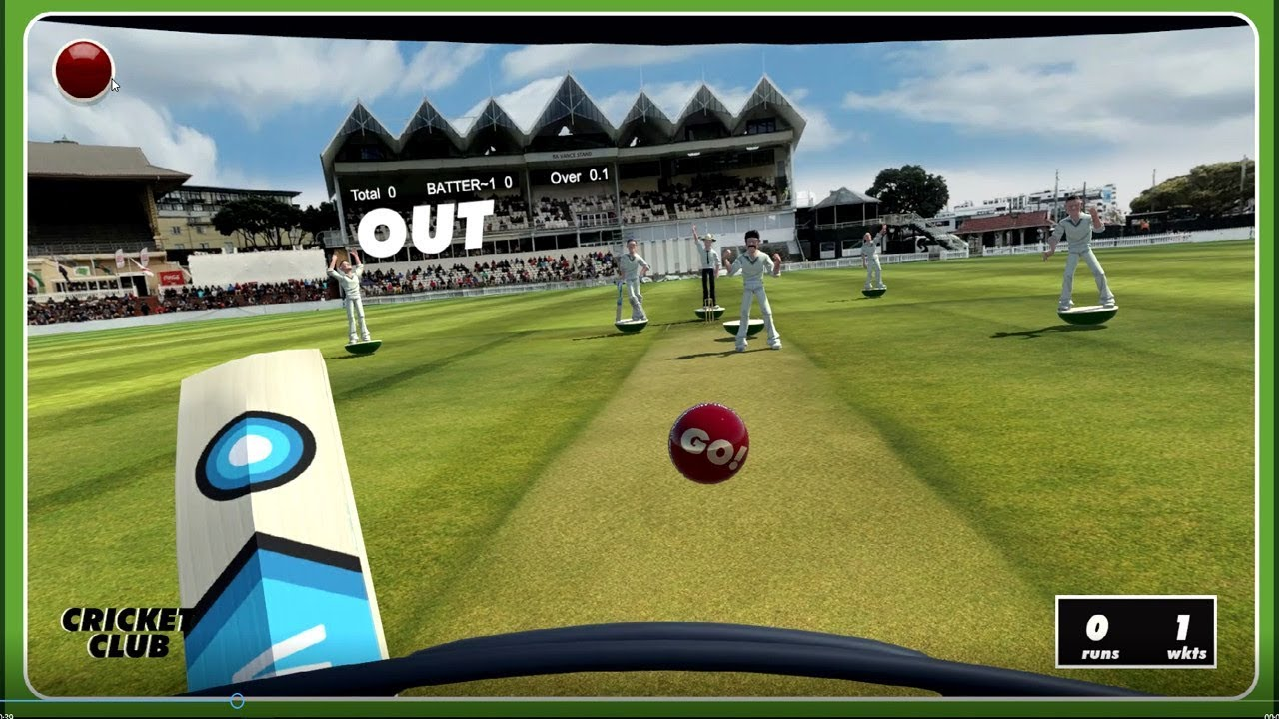

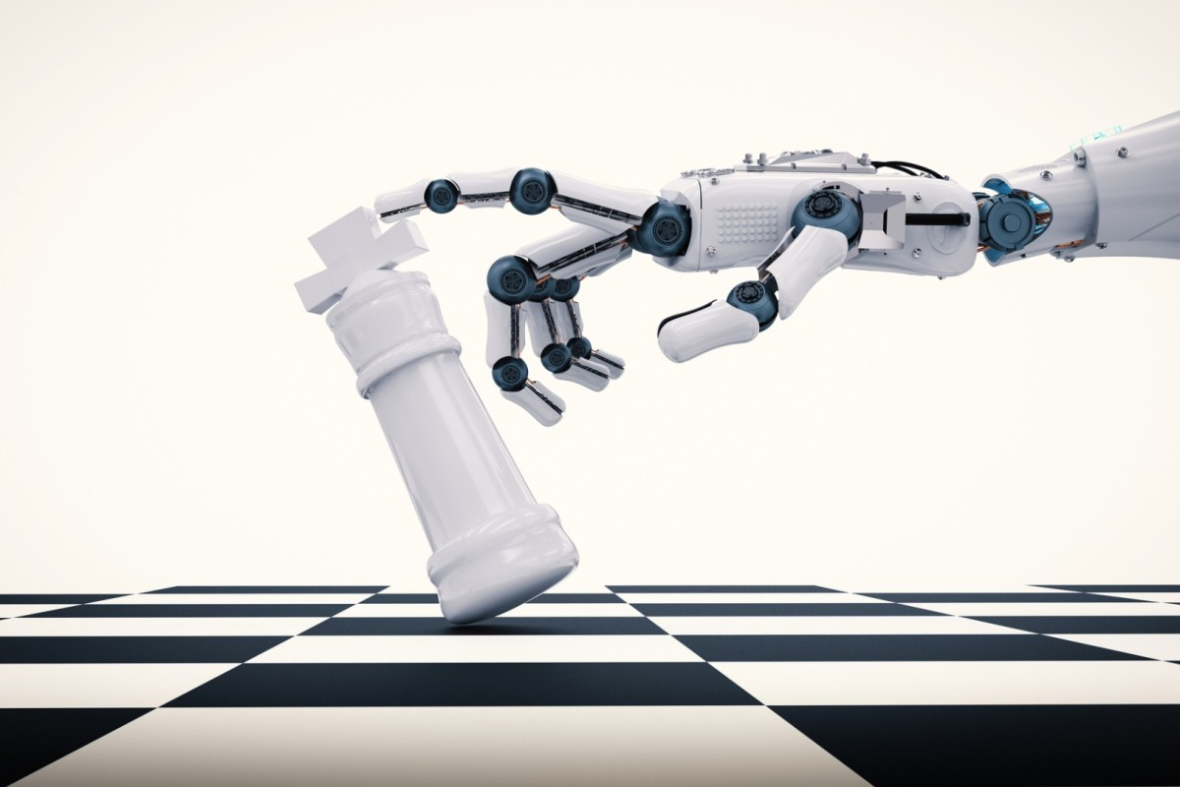
Playing the Game
10
11
12
The batsman can now start the training and face deliveries from the digital twin of the selected bowler
The AI algorithm modifies the deliveries based on the shots being played
The AI would can be set to try and beat the batsman using the bowling patterns and attributes of the bowler’s digital twin

Slide 27
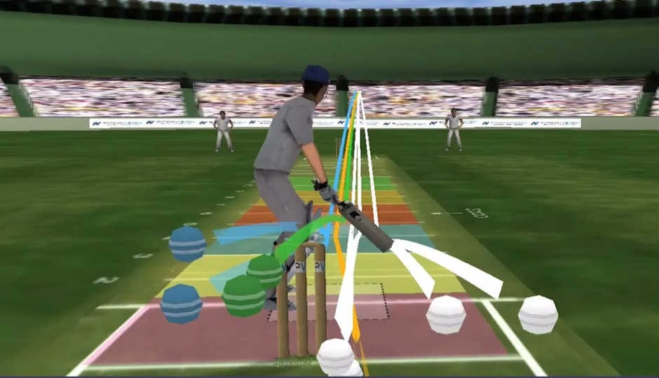
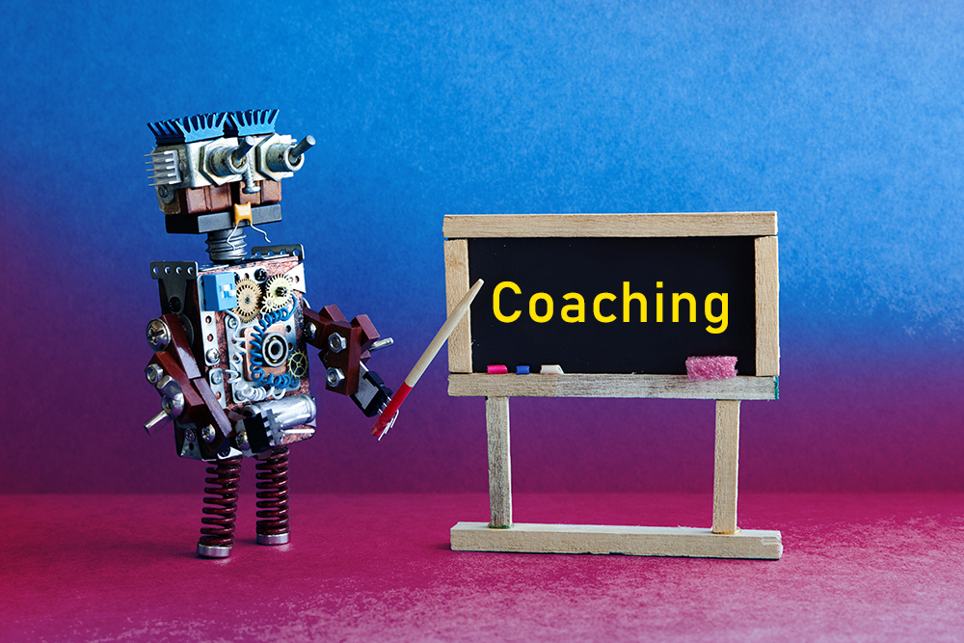
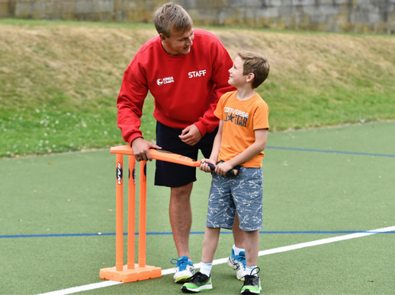
Playing the Game
13
14
15
The batsman can get ball by ball analytics throughout the course of the training
The Batsman would also get coaching advice from an AI based on the analysis of the playing style and patterns identified during the gameplay. The results can be saved for each individual batsman so that progress can be tracked over months/weeks/days
The statistics, analysis reports and technique mapping can also be discussed with a physical coach if the player is at an academy or is enrolled in a mentorship programme

Slide 28
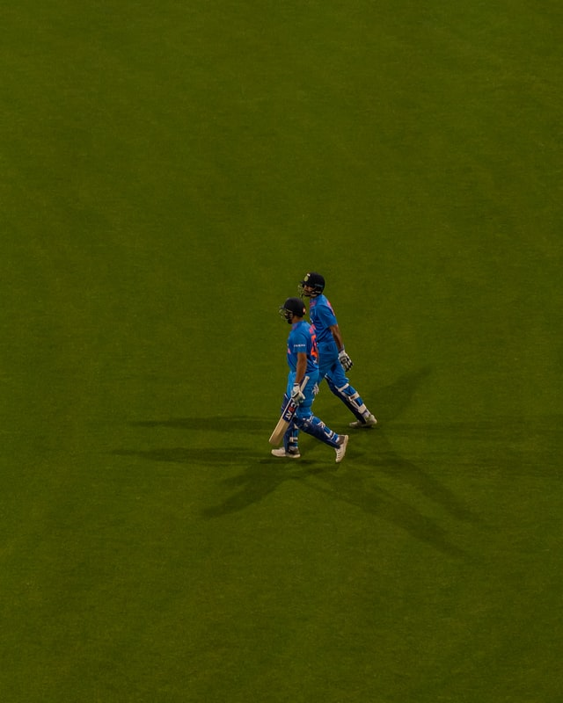

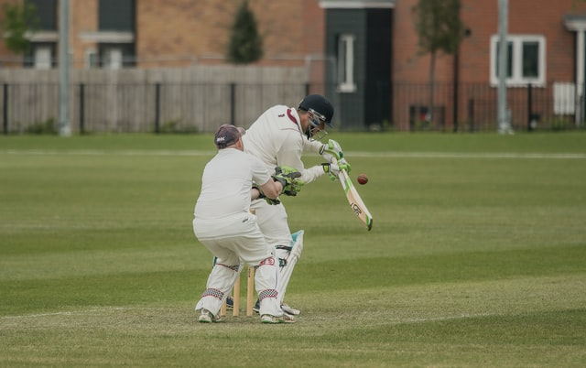
Playing the Game
16
17
18
The players get regular updates as new bowlers and features get added to the game
The batsman gets better by getting trained with International quality bowlers along with meaningful insights into his technique and playing style
The batsman gets results because of the all round training and makes it into the National Squad and proudly represents the country attributing his success to the Ecosystem

Slide 29
Thank you

